Slide 1



Unveiling the Gaps: Understanding Why LGBTQ Individuals Face Barriers to Cancer Screening
Joshua J. Cook, M.S. DS, M.S. CRM, ACRP-PM, CCRC
Swann Arp Adams, Ph.D., FACE, M.S.

Slide 2

My Background
2016 – FLVS
2021 – B.S., Biomedical Sciences
2023 – M.S., Clinical Research Management, ACRP Certifications
2024 – M.S., Data Science
2025 – M.D./Ph.D. Matriculation 🤞
M.D. – Oncology
Ph.D. – Cell Biology
*Bisexual*
Joshua J. Cook (joshua-j-cook-portfolios.netlify.app)

Slide 3
What’s this talk about?
Background on Queer Theory and LGBTQ Data-tracking
Barriers to Cancer Screening Among LGBTQ
Facilitators to Cancer Screening Among LGBTQ
Suggested Research Initiatives and Areas of Focus
Current T35 Research Project

Slide 4
Queer theory
Suggests that:
“the binary nature of heteronormativity through institutional practices, creates systemic discrimination against those who do not conform to traditional gender roles”
Heteronormativity – the assumption that heterosexuality (i.e., being attracted to the opposite sex) is the default, preferred, ‘normal’ state for human beings due to the belief that people fall into one category of a strict gender binary (Harris & White, 2018).
Gender Roles - the role or behavior considered to be appropriate to a particular gender as determined by prevailing cultural norms (Harris & White, 2018).
Goal: examine ways that heteronormativity influences cancer screening participation and providers’ treatment of LGBTQ individuals . Queer theory was used to highlight the privilege, unequal power distribution, and oppression that heteronormativity creates (Giffney, 2004) and the feelings of marginalization in LGBTQ populations.

Slide 5
LGBTQ Data Tracking
Coined as: Sexual orientation or Gender Identification (SOGI) Data
2012 – Gallup began tracking LGBTQ populations-based cancer data
2017 – 4.5% of U.S .publicly identify as lesbian, gay, bisexual, transgender, or queer (LGBTQ) – only a fraction included in studies
Today: specialized surveys (such as CDC BRFSS) have optional SOGI modules.
Many organizations do not track SOGI data related to cancer:
Centers for Disease Control (CDC) Prevention’s National Program of Cancer Registries
National Cancer Institute’s (NCI) Surveillance, Epidemiology, End Results Program
American College of Surgeons
American Cancer Society’s National Cancer Data Base
Very limited cancer data exists for LGBTQ populations despite…

Slide 6
LGBTQ and CANCER
LBGTQ have the highest rates of tobacco and alcohol use (Daniel & Butkus, 2015)
Both known contributors to elevated cancer risk, including:
Non-infectious
Infectious
Cervical (HPV)
Endometrial
Prostate
Anal (HPV, H. Pylori)
Breast
Lung
Colorectal

Slide 7
The journal article
Barriers and Facilitators to Cancer Screening Among LGBTQ Individuals With Cancer - PubMed (nih.gov)
Authors: Haviland Et. Al.
Year: 2020
Journal: Oncology Nursing Society
JIF: 1.9

Slide 8
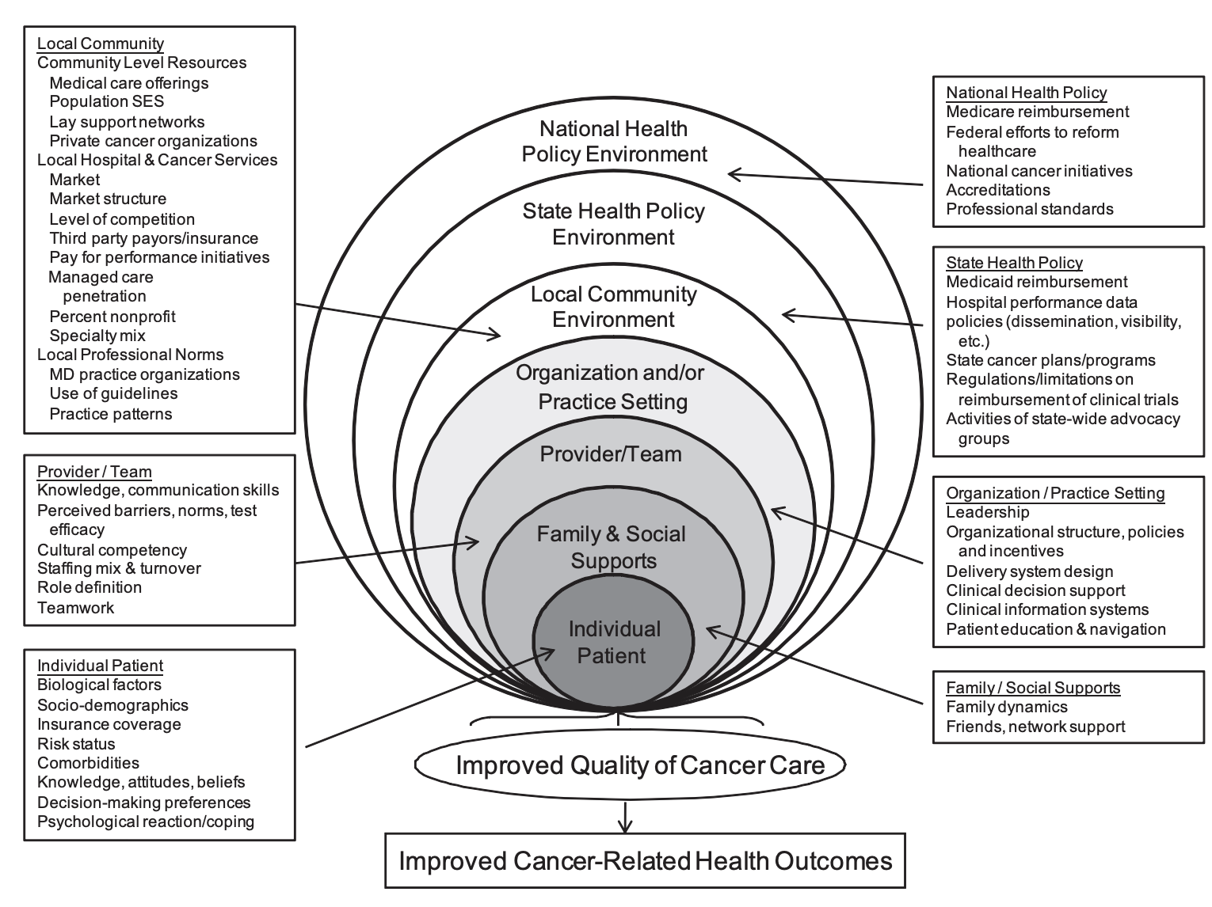
Methods
Systematic Review:
CINAHL, PsycINFO, PubMed databases
LGBTQ search terms
2008-2018
English, U.S.
Excluded HIV-focused articles (confounding factors)
Sample size (n) = 12 (survey or qualitative studies)
Followed integrative review framework and the Multilevel Influences on the Cancer Care Continuum (MICCC) framework
Taplin SH, Anhang Price R, Edwards HM, Foster MK, Breslau ES, Chollette V, . . . Zapka J. (2012). Introduction: Understanding and influencing multilevel factors across the cancer care continuum. Journal of the National Cancer Institute. Monographs, 2012(44), 2–10. 10.1093/jncimonographs/lgs008

Slide 9
Barriers to Cancer Screening Among LGBTQ via MICCC
Individual Patient:
Gender identity/expression
Sexual orientation
Racial/ethnic identity – also influenced perceptions of provider discrimination
Socioeconomic status
Provider and patient knowledge gaps
Poor psychosocial reaction and emotional coping
Lower educational attainment
Lower Likelihood of Cervical, Colon, Breast Cancer Screening:
Gender nonconforming
Transgender
Bisexual
Minority status
Educational attainment for women
Financial Instability
*Black lesbian, bisexual, and queer women reported negative screening experiences associated with perceived discrimination from provider

Slide 10
Barriers to Cancer Screening Among LGBTQ via MICCC
Screening:
Lacking LGBTQ guidelines
Knowledge of existing guidelines even more so
Lack of knowledge of Human Papillomavirus (HPV) transmission
Psychological and Coping-related Factors:
Psychological distress affecting transgender individuals when presenting for a Papanicolaou (PAP) test to screen for cervical cancer
Gender dysphoria
*Women who were open about sexual orientation to their providers were LESS likely to know about HPV’s role

Slide 11
Barriers to Cancer Screening Among LGBTQ via MICCC
Provider/Team:
Lacking LGBTQ-specific training, knowledge
Poor communication and teamwork skills
Assumptions about SOGI status – less pertinent education provided
Lack of knowledge on the anal PAP test in place of cervical (cheaper)
Fear of discrimination
Organization, Practice, Community Environment:
LGBTQ populations perceived a lack of acceptance in the current healthcare delivery system
Heteronormative assumptions
Fear of discrimination

Slide 12
Barriers to Cancer Screening Among LGBTQ via MICCC
Policy:
Most published guidelines are for cisgender individuals (i.e., those whose gender identity aligns with their birth-assigned sex)
Policy hurdles for transgender patients – need an advocate

Slide 13
Facilitators to Cancer Screening Among LGBTQ via MICCC
Individual Patient:
Matching race, ethnicity, social position, life experiences, or gender to the provider (for black lesbian, bisexual, and queer women)
Transgender individuals with feminine gender expression
Personal importance of routine appointments
Sexual activity
Previous findings on screenings
Having insurance
More education and higher income]
Family history of cancer
Positive role models/support system
*Not correlated with age

Slide 14
Facilitators to Cancer Screening Among LGBTQ via MICCC
Provider/Team:
Not assuming SOGI status, using open-ended questions regarding sexual orientation
Knowledge of same-sex sexual health and risk factors
Share demographic/socioeconomic status
Congruence in sexual orientation
Gentle physical touch during screening
Active listening
Allowing for self-collected PAP test samples
Previous positive contraceptive or screening experiences with provider
Organization, Practice, Community Environment:
Feeling welcomed by their provider and having their partner welcomed
Seen by a physician assistant or nurse practitioner > physician (more attention and time?)
Education on anal self-examination
*Lesbian and bisexual women and transgender men 4x more likely to be screened when recommended by a provider

Slide 15
Facilitators to Cancer Screening Among LGBTQ via MICCC
Policy:
States with legal protections related to SOGI populations have an 8% higher likelihood of having had colorectal cancer screening among LGBTQ populations; other types are not being monitored or do not have specific protections

Slide 16
Suggested Research Initiatives and Areas of Focus
Specific guidelines on LGBTQ health and clinical treatment
Education of LGBTQ patients on same-sex risks
Policy banning discrimination based on SOGI, physician training, and active data-monitoring
LGBTQ-specific research initiatives and funding (not just HIV – currently 75% of NIH funding, 1.8% for cancer)
Additional research using larger-scale studies to assess cancer screening barriers and facilitators among LGBTQ populations, as well as to understand providers’ lack of comfort with and knowledge of such screening.
Cancer screening data among LGBTQ populations would lead to identification of areas to implement public interventions.

Slide 17

Current T35 research project
Project Goal: Assess temporal trends (2014-present) in HPV vaccination and cervical cancer screening in relation to cervical cancer development by subgroup (SOGI v. non-SOGI, urban v. rural, racial/ethnic group).

Slide 18
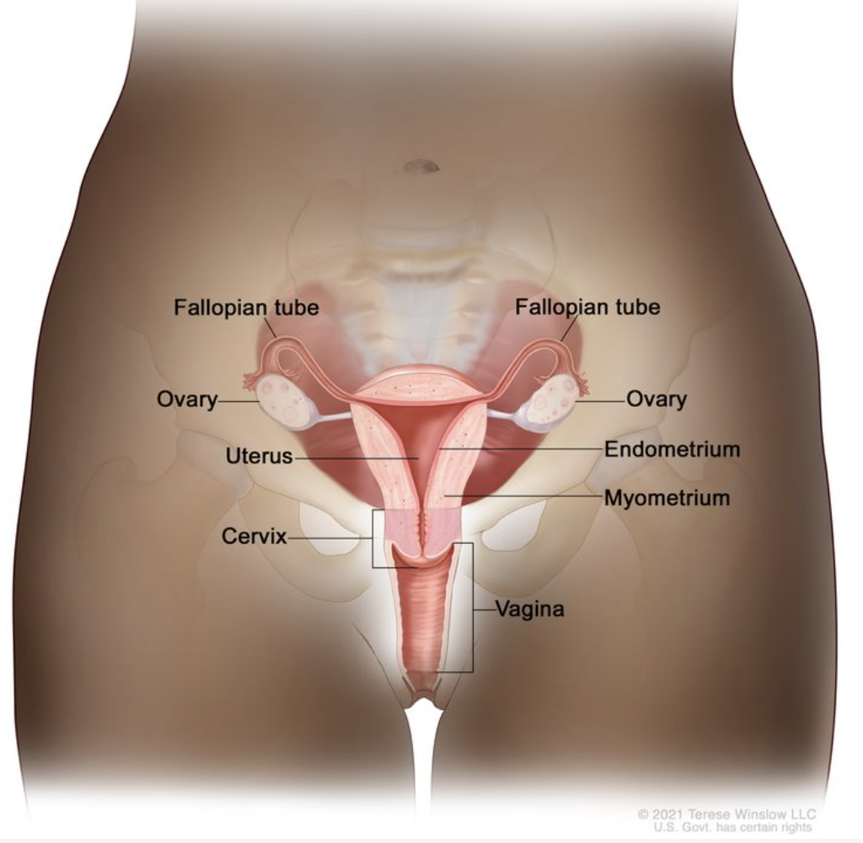
Current T35 research project
Cervical Cancer – a cancer (i.e., a mass of uncontrolled cell growth) that originates in the cervix.
#20 on top cancers list (13,820 new cases/year, 4,360 deaths/year as of 2024)
Slow developing
Preceded by dysplasia (abnormal cell growth)
Cervical Cancer Treatment (PDQ®) - NCI

Slide 19
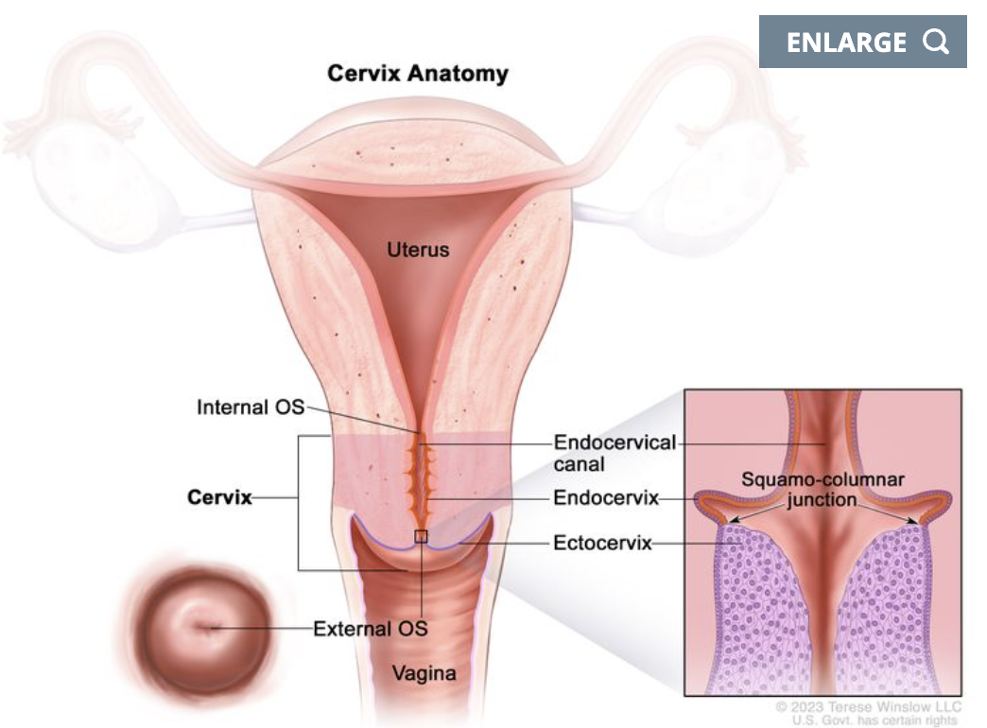
Current T35 research project
Two Types:
Squamous cell carcinoma (90% of cases) developing from the ectocervix
Adenocarcinoma developing from endocervix
Begins in the squamocolumnar junction (i.e., the middle)
Which is easier to assess clinically?
Cervical Cancer Treatment (PDQ®) - NCI

Slide 20
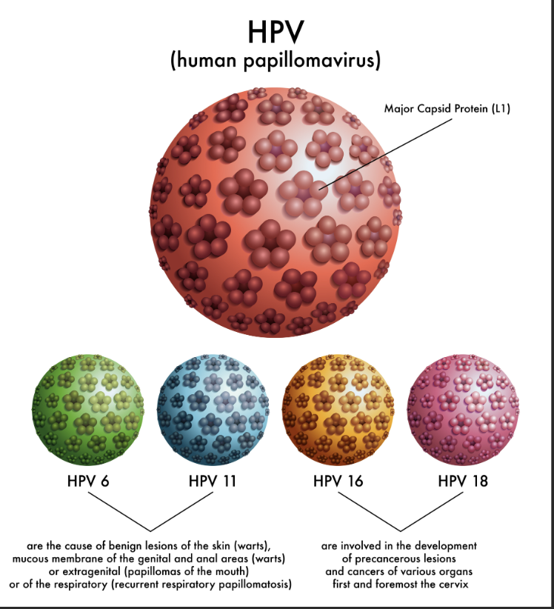
Current T35 research project
Most common cause: infection of the cervix with human papillomavirus (HPV)
Through sexual intercourse
Assessed clinically via Papanicolaou (Pap) test to detect cancerous cells
Vaccination available within certain age groups as of 2009
Most frequently diagnosed among women aged 35-44
5-year survival rate depends on if localized to primary site or metastasized
Cervical Cancer Treatment (PDQ®) - NCI

Slide 21
Current T35 research project
The Centers for Disease Control (CDC) maintains the annual (1988-present) Behavioral Risk Factor Surveillance System (BRFSS)
A rich source of survey data for public health and epidemiological research
BRFSS collects data in all 50 states as well as the District of Columbia and three U.S. territories
Includes data on individual-level demographics, health-related risk behaviors, chronic health conditions, and use of preventive services
OPTIONAL SOGI Module introduced ~2014

Slide 22
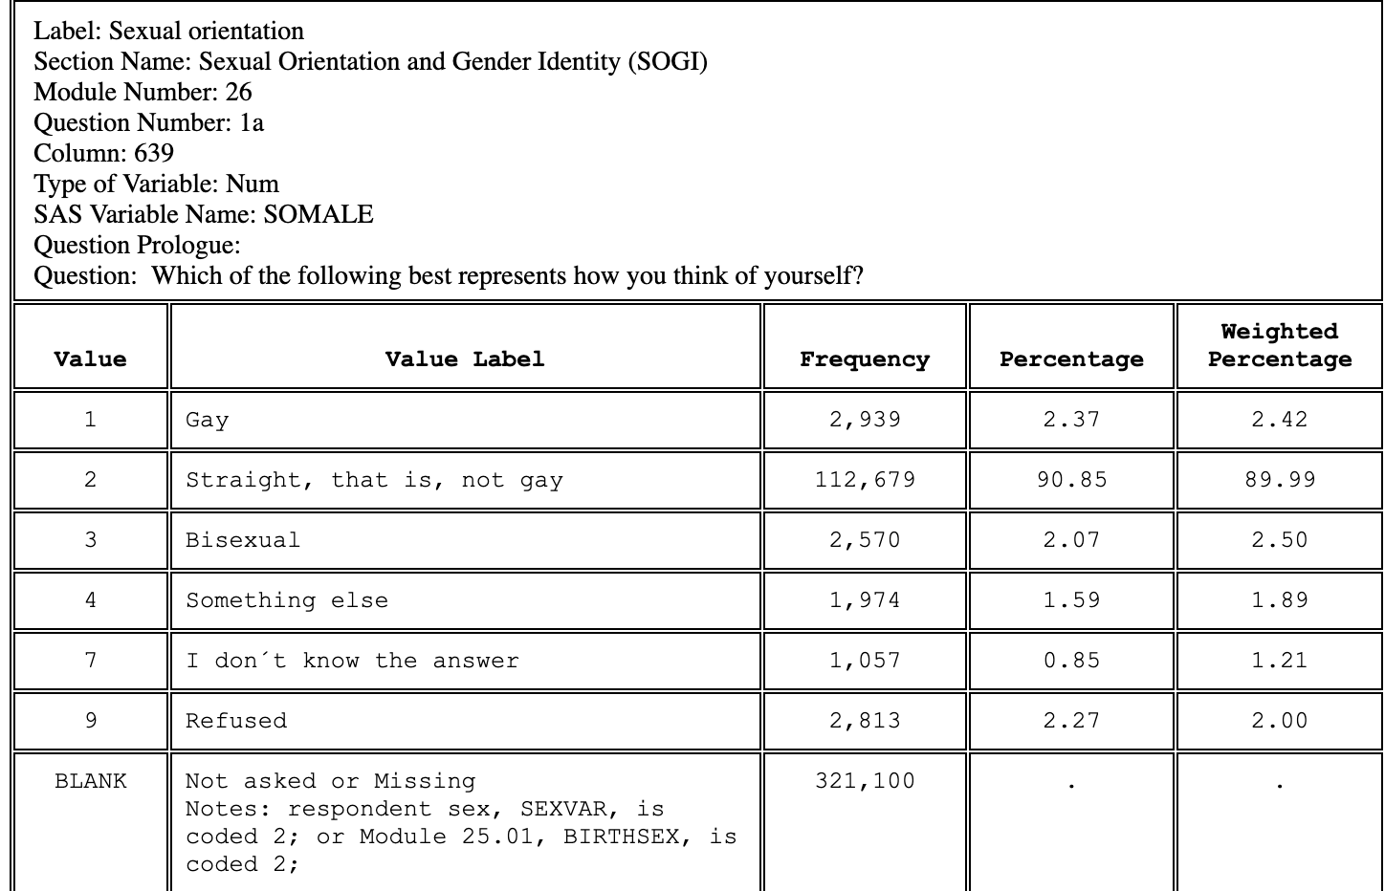
Current T35 research project
CDC - BRFSS

Slide 23
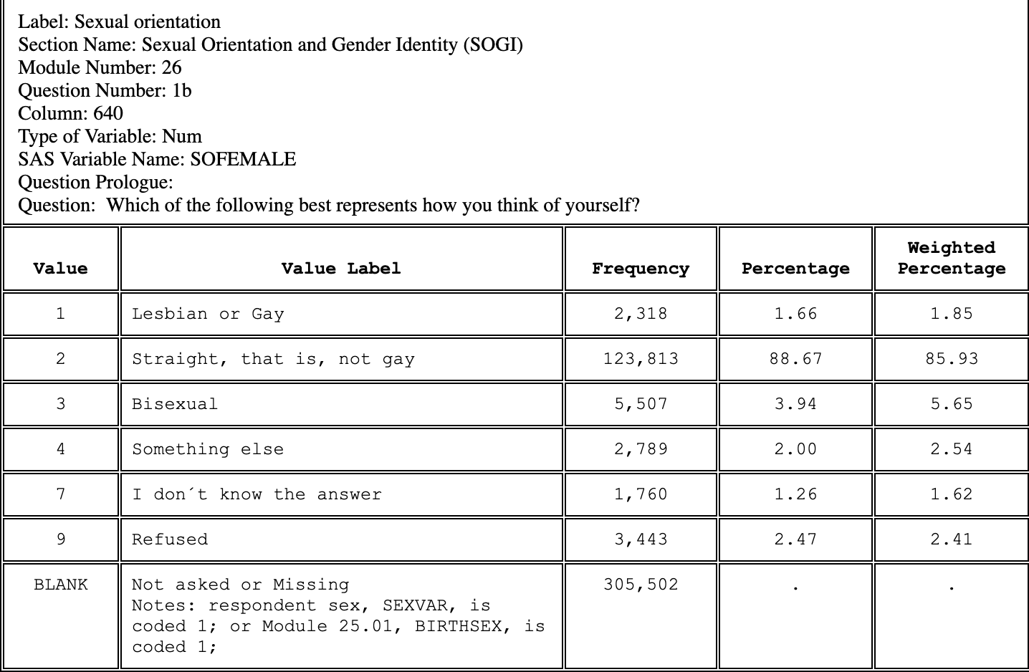
Current T35 research project
CDC - BRFSS

Slide 24
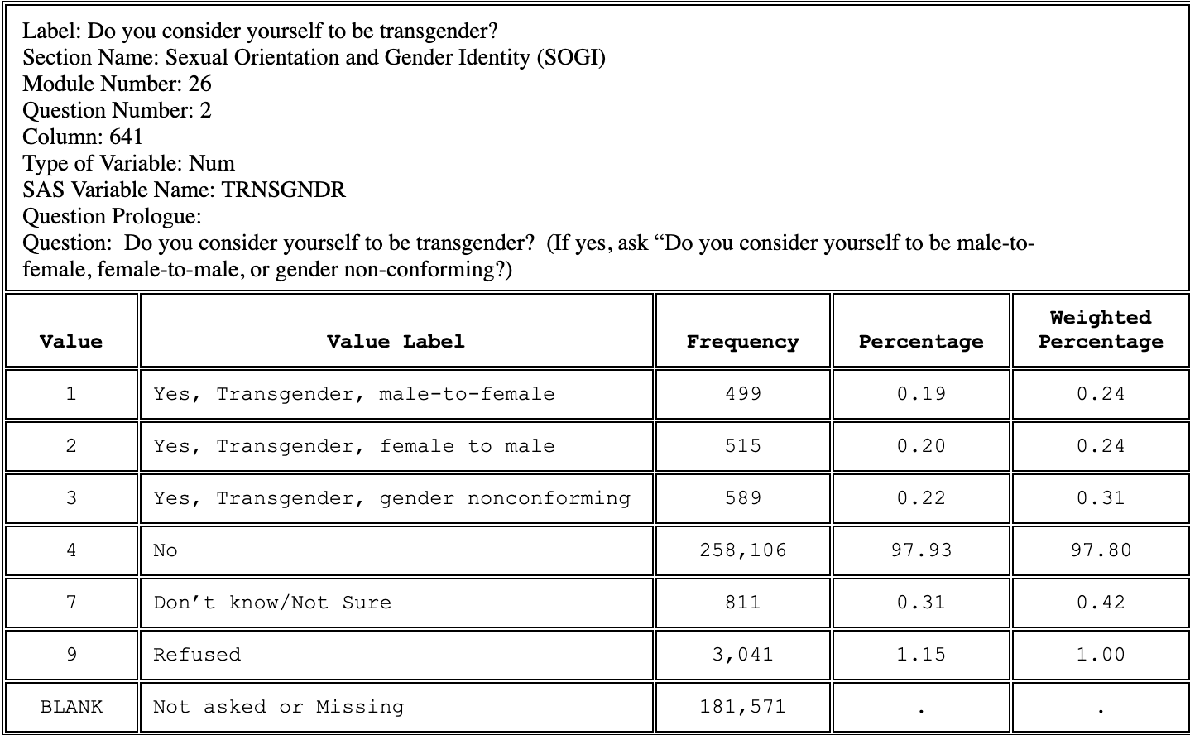
Current T35 research project
CDC - BRFSS

Slide 25
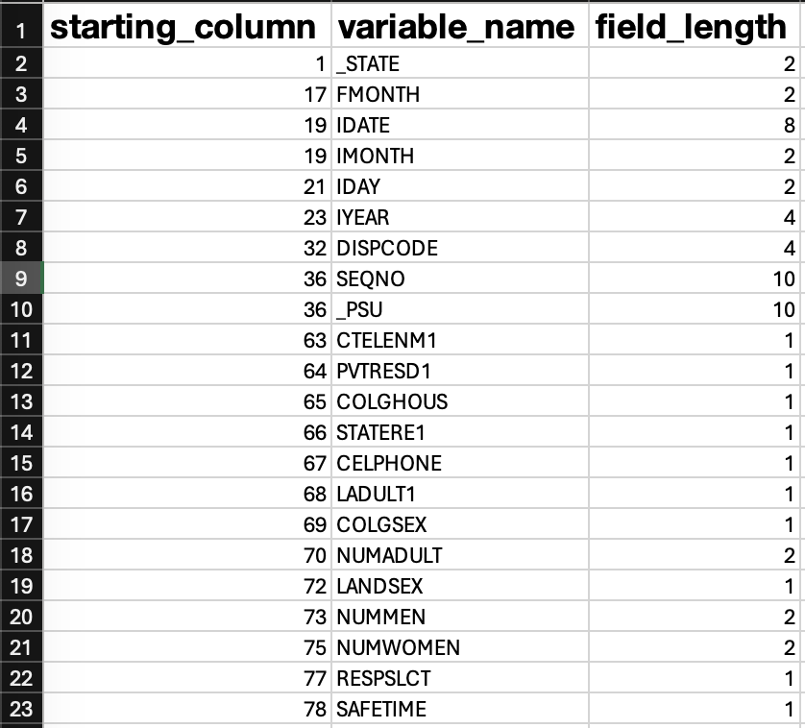
Current T35 research project
The data is stored as ASCII files, or SAS Transport Format
Must be read in with corresponding column lengths
2022 had 445,132 records, 471 columns; 2023 TBD
Codebooks and general survey information provided as PDF/HTML
CDC - BRFSS

Slide 26
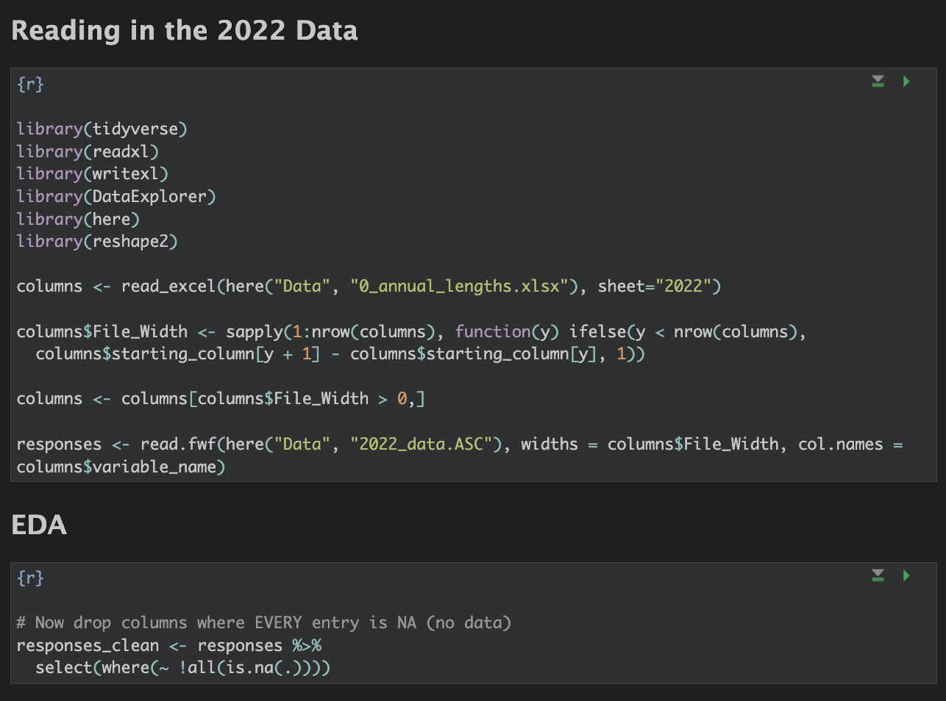
Current T35 research project
Some code:

Slide 27
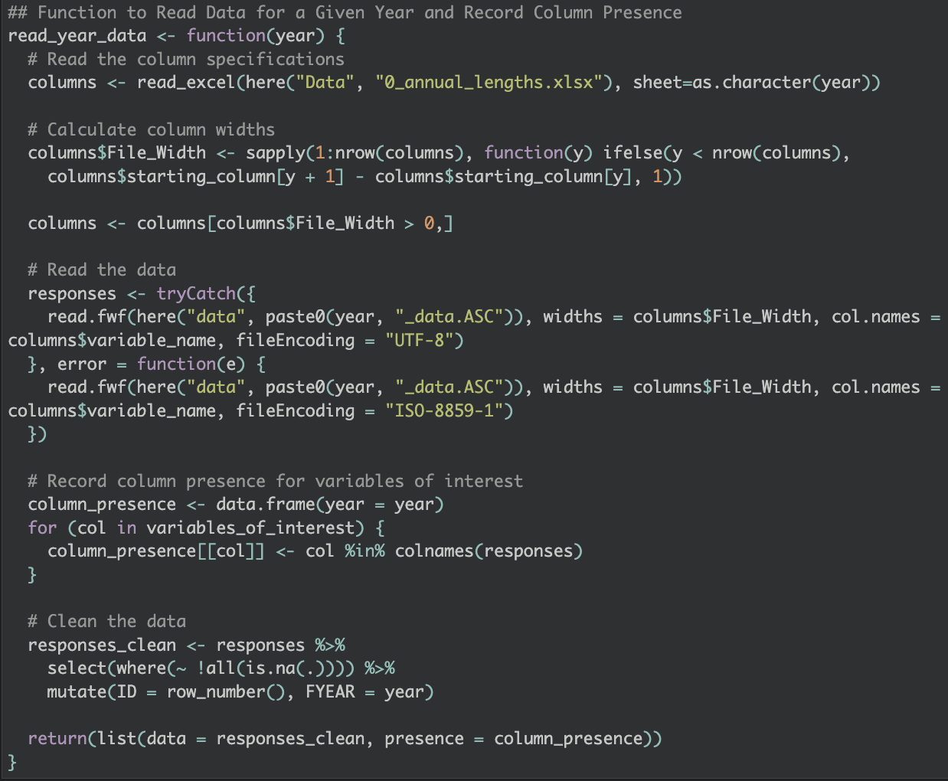
Current T35 research project
Some code:

Slide 28
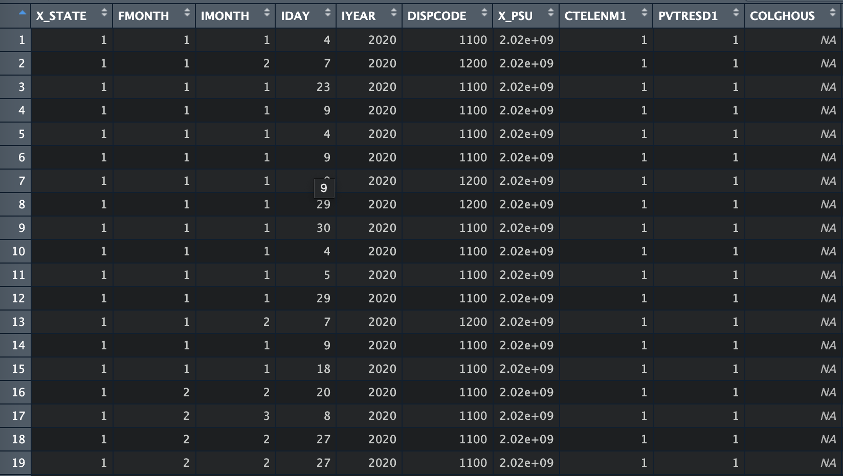
Current T35 research project
The dataframe:

Slide 29
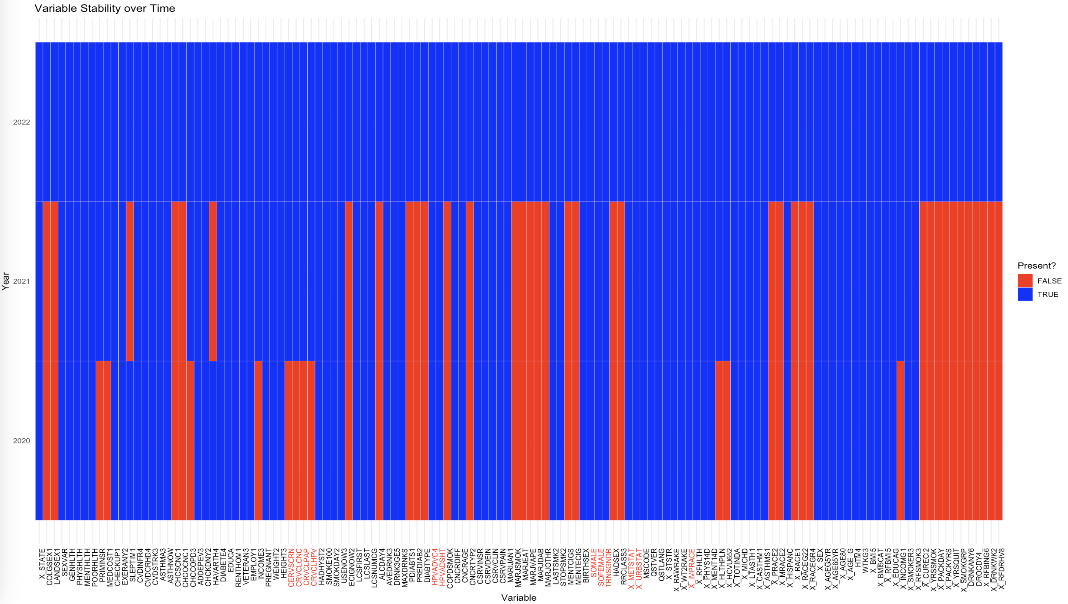
Current problem:

Slide 30
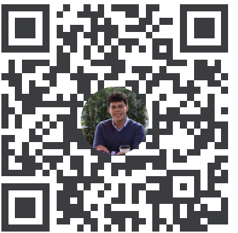
Thank you! Questions?
*Click me

Slide 31
References
Joshua J. Cook (joshua-j-cook-portfolios.netlify.app)
Harris J, & White V. (2018). A dictionary of social work and social care. Oxford, UK: Oxford University Press.
Giffney N. (2004). Denormatizing queer theory: More than (simply) lesbian and gay studies. Feminist Theory, 5, 73–78. 10.1177/1464700104040814
Haviland, K. S., Swette, S., Kelechi, T., & Mueller, M. (2020). Barriers and Facilitators to Cancer Screening Among LGBTQ Individuals With Cancer. Oncology nursing forum, 47(1), 44–55. https://doi.org/10.1188/20.ONF.44-55
Daniel H, & Butkus R. (2015). Lesbian, gay, bisexual, and transgender health disparities: Executive summary of a policy position paper from the American College of Physicians. Annals of Internal Medicine, 163, 135–137. 10.7326/M14-2482
Taplin SH, Anhang Price R, Edwards HM, Foster MK, Breslau ES, Chollette V, . . . Zapka J. (2012). Introduction: Understanding and influencing multilevel factors across the cancer care continuum. Journal of the National Cancer Institute. Monographs, 2012(44), 2–10. 10.1093/jncimonographs/lgs008
Cervical Cancer—Health Professional Version – NCI
Cervical Cancer — Cancer Stat Facts
CDC - BRFSS

